Slide 1
Software Development 2
Layout Managers
F27SB

Slide 2
Previously
Last time:
Swing
JFrames
Event listeners

Slide 3
Today’s Lecture
JLabels – how to display text
JPanels – containers for components
Using layout managers

Slide 4
Labels and text
public class JLabel extends JComponent
a rectangular box that can contain text
public JLabel()
create new JLabel with background only
public JLabel(String text)
create a new JLabel with text written in it

Slide 5
Labels and text
public JLabel(String text, int alignment)
alignment = position of text in JLabel
use SwingConstants to specify this:
SwingConstants.CENTER
SwingConstants.LEFT
SwingConstants.RIGHT
NB: JLabel implements SwingConstants so can also access them as JLabel.constant

Slide 6

Labels and text
new JLabel(“Hello”, JLabel.LEFT);
Hello
new JLabel(“Hello”, JLabel.CENTER);
Hello
new JLabel(“Hello”, JLabel.RIGHT);
Hello

Slide 7



Labels and text
new JLabel(“Hello”, JLabel.LEFT);
Hello
new JLabel(“Hello”, JLa
Hell
new JLabel(“Hello”, JLa
bel.CENTER);
o
bel.RIGHT);
Hello

Slide 8


Labels and text
public void setBackground(Color c)
set JLabel’s background colour to c
public void setForeground(Color c)
set JLabel’s foreground colour to c

Slide 9
Labels and text
Can change font by providing a Font object:
public class Font
public Font(String name, int style, int size)
font names are strings, e.g.
“Serif”
“Sansserif”
“Monospaced”
uses a default serif font
uses a sans serif font
uses a monospaced font
– “Arial Black” - uses the specified font

Slide 10
Labels and text
Font style is specified using constants in Font:
Font.PLAIN
this is plain serif
Font.BOLD
this is bold sanserif
Font.ITALIC
this is italic monospaced
Font.BOLD|Font.ITALIC
this is bold and italic serif

Slide 11

Labels and text
Font size is measured in “points”
– Specified the height of a capital X
– 1/72 inch, 0.353mm
12 point 14 point 16 point 18 point 24 point 28 point 32 point
e.g.
Font f1 = new Font(“Serif”,Font.BOLD,18);

Slide 12



Labels and text
public void setFont(Font f)
changes a Component‘s font
JLabel l = new JLabel(“hello”); l.setFont(f1);
Hello
l.setFont(new Font(“Arial”,Font.ITALIC,24));
Hello

Slide 13

Labels and text
public void setText(String text)
set JLabel’s text to text
e.g. l.setText(“Goodbye”);
Goodbye
use to provide messages on window
instead of println on console screen

Slide 14

Labels and text
Many JComponents also support HTML
– useful for more complex formatting, e.g.
l.setText("<html><font color=red> red</font><br><b>bold<b><br>
<i>italic</i></html>");
red bold italic

Slide 15
Controlling how components are arranged
LAYOUT MANAGERS

Slide 16
Layout managers
Controls size and placement of Components within Containers
These are designed to make your life easier
You don’t need to specify the exact positions of everything on screen
This is determined automatically according to a layout manager’s set of rules
However, you can get unexpected results if you don’t understand these rules!

Slide 17
Layout managers
Controls size and placement of Components within Containers
public abstract interface LayoutManager public abstract interface LayoutManager2
There are a number of different implementations
BorderLayout
GridLayout
FlowLayout
BoxLayout
GridBagLayout

Slide 18


Layout managers
Use these methods of a Container:
public void setLayout(LayoutManager mgr)
set Container’s layout manager to mgr
public Component add(Component comp)
add Component comp in next position in
Container
position depends on LayoutManager

Slide 19

Border layout
public class BorderLayout
implements LayoutManager2
holds Components in five locations:
North
West | Center | East
South

Slide 20

Border layout
public BorderLayout()
public Component add(Component comp,
int name)
add comp to location identified by name from
SwingConstants:
– CENTER, EAST, NORTH, WEST, SOUTH
added Component will fill area
area sizes adjusted so that all added Components fit
BorderLayout is default for JFrame

Slide 21

Border layout: example
import java.awt.*; import java.awt.event.*; import javax.swing.*;
class Border extends JFrame
{ JLabel N = new JLabel("TOP", JLabel.CENTER); JLabel S = new JLabel("BOTTOM", JLabel.CENTER);
JLabel E = new JLabel("RIGHT", JLabel.CENTER); JLabel W = new JLabel("LEFT", JLabel.CENTER); JLabel C = new JLabel("MIDDLE", JLabel.CENTER);

Slide 22
Border layout: example
public Border()
{ Container cpane = getContentPane();
Font f = new Font("Sansserif",Font.BOLD,18); N.setBackground(Color.white);
N.setFont(f); N.setOpaque(true);
cpane.add(N, BorderLayout.NORTH);
E.setBackground(Color.green);
E.setFont(f); E.setOpaque(true);
cpane.add(E, BorderLayout.EAST); S.setBackground(Color.lightGray); S.setFont(f);
S.setOpaque(true);

Slide 23
Border layout: example
cpane.add(S, BorderLayout.SOUTH); W.setBackground(Color.yellow); W.setFont(f);
W.setOpaque(true);
cpane.add(W, BorderLayout.WEST); C.setBackground(Color.black); C.setForeground(Color.white);
C.setFont(f); C.setOpaque(true);
cpane.add(C, BorderLayout.CENTER);
}
}

Slide 24
Border layout: example
class TestBorder
{ public static void main(String [] args)
{ Border b;
b = new Border(); b.setSize(300,320); b.setTitle("Border"); b.setVisible(true);
b.setDefaultCloseOperation(JFrame.EXIT_ON_CLOSE);
}
}

Slide 25
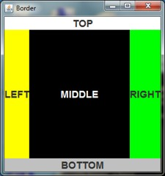
Border layout: example
Note that:
North and south regions are just tall enough for their contents
East and west regions are just wide enough for theirs
The centre region takes up any remaining space

Slide 26


Border layout
public setHgap(int hgap)
sets horizontal space between BorderLayout areas (hgap = horizontal spacing between areas)
public setVgap(int vgap)
similarly for vertical space between areas
Space is in background colour of
Container

Slide 27
Which one will work?
Both commands are syntactically correct
((BorderLayout)getContentPane()
.getLayoutManager())
.setHgap(10);
((BorderLayout)getLayoutManager())
.setHgap(10);
Notes:
((BorderLayout)getContentPane()
.getLayoutManager())
.setHgap(10);

Slide 28
Which one will work?
Both commands are syntactically correct
getContentPane()
.setLayout(new BorderLayout());
setLayout(new BorderLayout());
Notes:
getContentPane()
.setLayout(new BorderLayout());

Slide 29
Grid layout
public class GridLayout
public GridLayout(int rows, int cols)
Container has rows rows of cols
columns
all regions are the same size
public Component add(Component comp)
comp sized to fit exactly in area
Components added in order
– left to right, then top to bottom

Slide 30

Grid layout: example
e.g. 3*2 grid of numbered labels
import java.awt.*; import java.awt.event.*; import javax.swing.*;
class Grid extends JFrame { static final int LABNO = 6;
JLabel [] labels = new JLabel[LABNO]; Color [] colors =
{Color.red,Color.blue,Color.green, Color.yellow,Color.white,Color.lightGray};

Slide 31

Grid layout: example
public Grid() {
setLayout(new GridLayout(3,2));
Font f = new Font("Sansserif",Font.BOLD,18); for(int i=0;i<LABNO;i++) {
labels[i] =
new JLabel(i+"",JLabel.CENTER); labels[i].setFont(f);
labels[i].setBackground(colors[i]); labels[i].setOpaque(true); add(labels[i]);
}
}
}

Slide 32
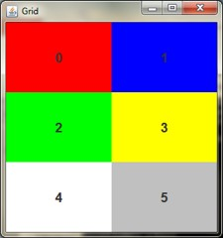
Grid layout: example
class TestGrid
{ public static void main(String [] args)
{ Grid g = new Grid(); ... }

Slide 33

Would this work as well?
for(int i=0;i<LABNO;i++) {
labels[i] = new JLabel(i+"",JLabel.CENTER);
add(labels[i]); labels[i].setFont(f); labels[i].setBackground(colors[i]); labels[i].setOpaque(true);
}

Slide 34
Flow layout
public class FlowLayout
public Component add(Component comp)
places Components
left to right
top to bottom
does not use a grid
makes Components as small as is compatible with contents

Slide 35

Flow layout
e.g. 6 coloured/named labels
import java.awt.*; import java.awt.event.*; import javax.swing.*;
class Flow extends JFrame { static final int LABNO = 6;
JLabel [] labels = new JLabel[LABNO]; Color [] colors =
{Color.red,Color.blue,Color.green, Color.yellow,Color.pink,Color.orange};
static String [] words =
{"RED","BLUE","GREEN","YELLOW","PINK","ORANGE"};

Slide 36
Flow layout
public Flow() {
setLayout(new FlowLayout());
Font f = new Font("Sansserif",Font.BOLD,24); for(int i=0;i<LABNO;i++) {
labels[i] = new JLabel(words[i]);
labels[i].setFont(f); labels[i].setBackground(colors[i]); labels[i].setOpaque(true); add(labels[i]);
}
}
}

Slide 37

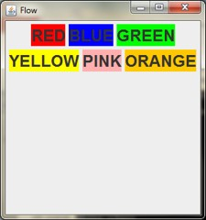
Flow layout
class TestFlow
{ public static void main(String [] args)
{ Flow f = new Flow(); ... }

Slide 38
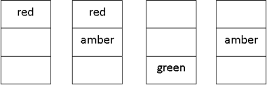
Example: traffic lights
UK traffic light sequence
3 * 1 Grid of textless JLabels
change background(s) to change lights
use pause to delay between each state

Slide 39
Example: traffic lights
import java.awt.*; import java.awt.event.*; import javax.swing.*;
class Lights extends JFrame
{ final int LIGHTNO = 3;
JLabel [] lights = new JLabel[LIGHTNO]; final long DELAY = 1000;

Slide 40
Example: traffic lights
public Lights()
{ setLayout(new GridLayout(3,1)); lights[0] = new JLabel(); lights[0].setBackground(Color.red); lights[1] = new JLabel(); lights[1].setBackground(Color.white); lights[2] = new JLabel(); lights[2].setBackground(Color.white); for(int i=0;i<LIGHTNO;i++)
{ lights[i].setOpaque(true); add(lights[i]);
}
}

Slide 41
Example: traffic lights
public void change()
{ while(true)
{ pause(DELAY); lights[1].setBackground(Color.orange); pause(DELAY); lights[0].setBackground(Color.white); lights[1].setBackground(Color.white); lights[2].setBackground(Color.green); pause(DELAY);
lights[1].setBackground(Color.orange); lights[2].setBackground(Color.white);
pause(DELAY); lights[0].setBackground(Color.red); lights[1].setBackground(Color.white);
}
} }

Slide 42





Example: traffic lights
class TestLights
{ public static void main(String [] args)
{ Lights l = new Lights(); ... }
}

Slide 43
Panel
public class JPanel extends Component
Component that must be contained in another Component or a Container
use to group Components together
public JPanel()
default LayoutManager is FlowLayout
public JPanel(LayoutManager layout)
sets LayoutManager to layout

Slide 44

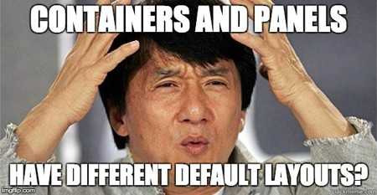
Panel
public class
Component
another Co
use to group
public JPan
default LayoutManager is FlowLayout
public JPanel(LayoutManager layout)
sets LayoutManager to layout
JPanel extends Component
that must be contained in
mponent or a Container
Components together
el()

Slide 45
Panel: example
e.g. add text message to traffic lights
red ==> STOP; red/amber ==> READY; green ==> GO; amber ==> SLOW
JPanel JLabel
JFrame
red
text
JLabel
JLabel
orange
JLabel
green

Slide 46
Panel: example
JFrame => GridLayout => 1 row * 2 columns JPanel => GridLayout => 3 rows * 1 column
...
class TLights extends JFrame
{ final int LIGHTNO = 3;
JLabel [] lights = new JLabel[LIGHTNO]; final long DELAY = 1000;
JPanel display;
JLabel text;

Slide 47
Panel: example
public TLights()
{ int i;
setLayout(new GridLayout(1,2));
lights[0] = new JLabel(); lights[0].setBackground(Color.red); lights[1] = new JLabel(); lights[1].setBackground(Color.white); lights[2] = new JLabel(); lights[2].setBackground(Color.white);

Slide 48
Panel: example
display = new JPanel(new GridLayout(3,1)); for(i=0;i<LIGHTNO;i++)
{ lights[i].setOpaque(true);
display.add(lights[i]);
}
add(display);
text = new JLabel("STOP",JLabel.CENTER); text.setFont
(new Font("Serif",Font.BOLD,24)); text.setBackground(Color.lightGray);
text.setOpaque(true); add(text);
}

Slide 49
Panel: example
public void change()
{ while(true)
{ pause(DELAY); lights[1].setBackground(Color.orange); text.setText("READY");
pause(DELAY); lights[0].setBackground(Color.white); lights[1].setBackground(Color.white);
lights[2].setBackground(Color.green);
text.setText("GO");
pause(DELAY); lights[1].setBackground(Color.orange); lights[2].setBackground(Color.white); text.setText("SLOW");

Slide 50
Panel: example
pause(DELAY); lights[0].setBackground(Color.red); lights[1].setBackground(Color.white); text.setText("STOP");
}
}
}
class TestTLights
{ public static void main(String [] args)
{ TLights tl = new TLights(); ... }
}

Slide 51
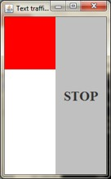
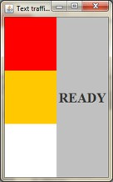
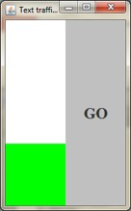
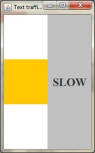
Panel: example

Slide 52
Window interaction with keyboard & display
JFrame created by a program is in addition to and independent of screen/ keyboard window
can still interact with program via display/keyboard
use program interaction to change
JFrame

Slide 53
Window interaction with keyboard & display
e.g. repeatedly request/input name of colour via screen/keyboard, and display colour and name in JFrame
JFrame
colour
JLabel
JLabel
name

Slide 54
Window interaction with keyboard & display
class Colours extends JFrame
{ JLabel C,T;
public Colours()
{ C = new JLabel(); C.setBackground(Color.white); C.setOpaque(true);
T = new JLabel("",JLabel.CENTER);
T.setFont(new Font("Serif",Font.BOLD,36)); T.setBackground(Color.white); T.setOpaque(true);
setLayout(new GridLayout(2,1)); add(C);
add(T);
}

Slide 55
Window interaction with keyboard & display
public void setColour(String name)
{ Color colour = Color.white; if(name.equals("green"))
colour=Color.green; else if(name.equals("red"))
colour=Color.red; else
if(name.equals("blue")) colour=Color.blue;
else name="?"+name+"?";
C.setBackground(colour); T.setText(name);
} }

Slide 56

Window interaction with keyboard & display
class TestColours
{ static BufferedReader keyboard = new BufferedReader
(new InputStreamReader(System.in)); static PrintWriter screen =
new PrintWriter(System.out,true);
public static void main(String [] args) throws IOException
{ Colours c = new Colours();
...
while(true)
{ screen.println("Enter name of colour"); c.setColour(keyboard.readLine());
}
} }

Slide 57
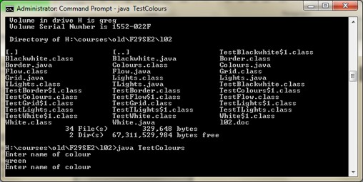
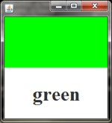
Window interaction with keyboard & display

Slide 58
THAT’S IT

